Slide 1
GSU Analytics 2016 Sprint Experience
What are the conditions that affect user experience in a mobile network?
XIN XIONG

Slide 2
Data
Summary
Python script developed to generate description of each attribute

Slide 3
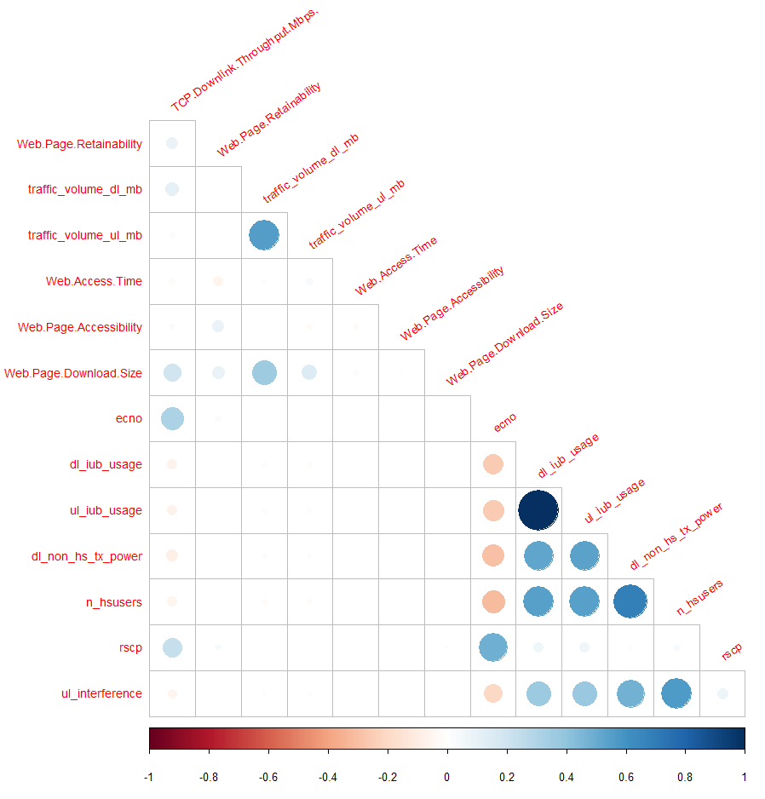
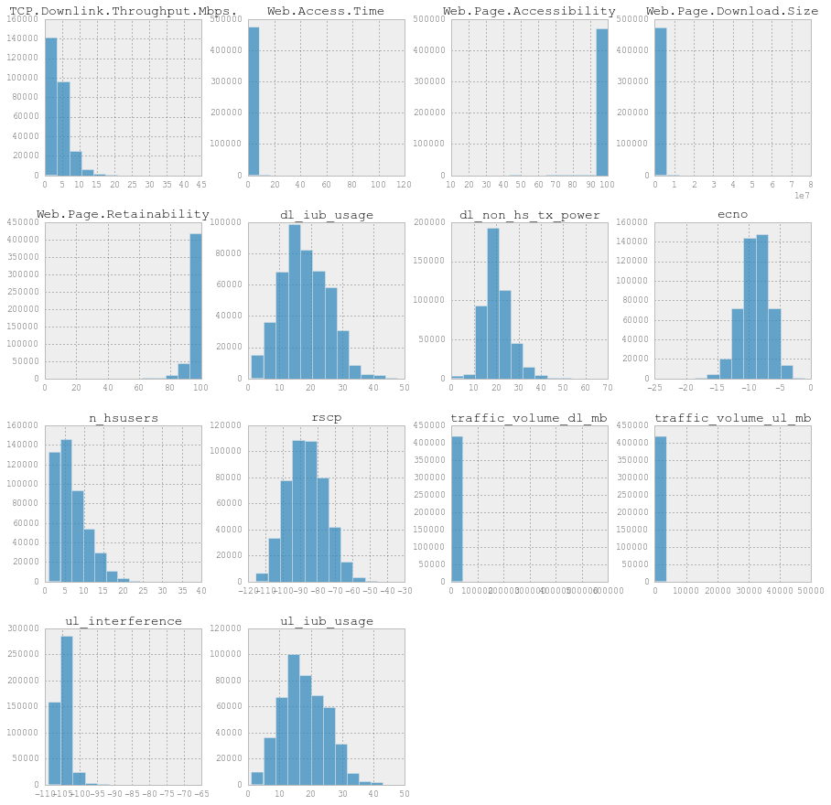
Data
Summary
Continuous Feature Distributions
Correlation
Matrix

Slide 4
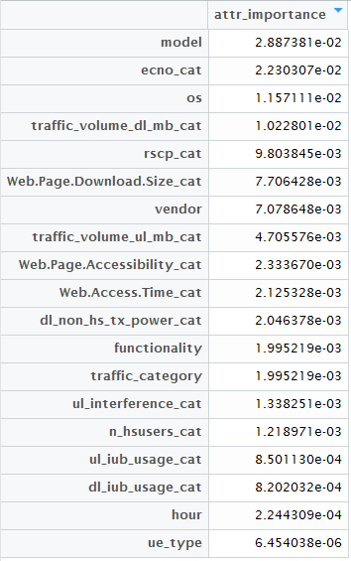
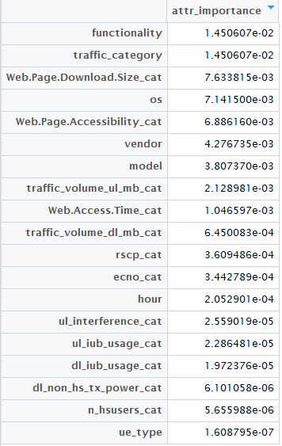
Data
Summary
Symmetric Uncertainty
Throughput
Retainability

Slide 5
Differences in KPIs across vendors
Note the varied throughput levels from vendors with similar RSCP
86
85
88
88
87
85
Average RSCP
89

Slide 6
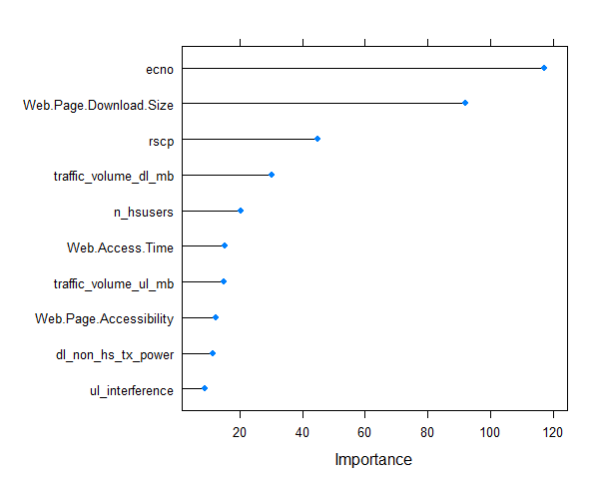
Variables
Linear Model
Predicting Throughput
B < 0.75 0.75 < G < 5 5 < E | Actual
Predicted |  | B | G | E
 | B | 53 | 62 | 5
 | G | 4248 | 64925 | 21233
 | E | 151 | 5975 | 6320
Accuracy : 0.6924
95% CI : (0.6896, 0.6952)
No Information Rate : 0.6891
P-Value [Acc > NIR] : 0.01189
Kappa : 0.1516
Mcnemar's Test P-Value : < 2e-16
Class: B Class: G Class: E
Sensitivity 0.0119048 0.9149 0.22933
Specificity 0.9993199 0.2040 0.91877
Pos Pred Value 0.4416667 0.7181 0.50779
Neg Pred Value 0.9572298 0.5196 0.76539
Prevalence 0.0432351 0.6891 0.26763
Detection Rate 0.0005147 0.6305 0.06138
Detection Prevalence 0.0011654 0.8780 0.12087
Balanced Accuracy 0.5056123 0.5594 0.57405
Accuracy : 0.8608
95% CI : (0.8587, 0.8629)
No Information Rate : 0.8603
P-Value [Acc > NIR] : 0.3188
Kappa : 0.0392
Mcnemar's Test P-Value : <2e-16
Sensitivity : 0.99614
Specificity : 0.02746
Pos Pred Value : 0.86317
Neg Pred Value : 0.53596
Prevalence : 0.86031
Detection Rate : 0.85699
Detection Prevalence : 0.99284
Balanced Accuracy : 0.51180
B < 1.5 Mbps | Actual
Predicted |  | B | G
 | B | 395 | 342
 | G | 13989 | 88246

Slide 7
Variable Reduction
Step-1 Selected top 6 variables with information Gain values
Variable Names | Information Gain
model | 0.079052362
ecno | 0.029059994
vendor | 0.01943998
os | 0.019006553
rscp | 0.018191582
Web.Page.Download.Size | 0.016213157
Model and ecno turns out to be most significant variables in determining throughput
Vendor and model have the highest correlation value. Dropping vendor as it has lower information as compared to model.
Step-2 Finding correlation Matrix with top 6 variables
Variables | model | ecno | vendor | os | rscp | Web.Page.Download.Size
model | 1.00 | -0.04 | 0.57 | -0.24 | 0.02 | -0.01
ecno | -0.04 | 1.00 | -0.08 | 0.04 | 0.47 | 0.00
vendor | 0.57 | -0.08 | 1.00 | -0.39 | -0.05 | -0.01
os | -0.24 | 0.04 | -0.39 | 1.00 | 0.03 | -0.05
rscp | 0.02 | 0.47 | -0.05 | 0.03 | 1.00 | 0.02
Web.Page.Download.Size | -0.01 | 0.00 | -0.01 | -0.05 | 0.02 | 1.00
ecno and rscp have the second highest correlation value. Dropping rscp as it has lower information as compared to model.

Slide 8
Model- Tree Based Classification
Final variables used in tree
Model
Output of the model
Variable Importance
Methodology1- C5.0 decision tree
Dataset | Accuracy
Training | 69.48%
Validation | 67.59%
Final Variables
model
ecno
os
Web.Page.Download.Size
Variables | Overall
ecno | 53.8
Web.Page.Download.Size | 42.8
model | 3.0
os | 0.5
Methodology2- trees boosting
Dataset | Accuracy
Training | 69.09%
Validation | 67.90%
Confusion Matrix of C5.0
Interpretation
 | Predicted
Actual |  | B | G | E | Row Total
 | B | 25916 | 6284 | 221 | 32421
 | G | 7569 | 14234 | 1278 | 23081
 | E | 492 | 4403 | 2084 | 6979
 | Column Total | 33977 | 24921 | 3583
1. Boosting which is the process of adding weak learners has the insignificant improvement in the accuracy

Slide 9
Decision Tree – Grouping Variables
OS and Vendor variables combined into groups
Groups
Final Model Variables
Confusion Matrix of C5.0
OS
Android
iOS
other
OS
vendor
ecno
ulu
interference
 | Predicted
Actual |  | B | G | E | Row Total
 | B | 42019 | 11432 | 538 | 53989
 | G | 24900 | 12639 | 874 | 38413
 | E | 5430 | 5269 | 1033 | 11732
 | Column Total | 72349 | 29340 | 2445
HTC
Nokia
LG
Apple
Sony
other
Vendor
Operating systems and vendors which accounted for a small % of the total were grouped into one category → “other”
ecno, ulu, and interference were grouped using the Discretize function
Accuracy = 53.45%

Slide 10
Random Forest - Throughput
Final Variables
traffic_volume_dl_mb
Rscp
Vendor
Functionality
Ecno
Os
Web.Page.Download.Size
Final Variables | MeanDecreaseGini
traffic_volume_dl_mb | 8109.1549
Rscp | 7996.4184
Vendor | 3394.5760
Functionality | 534.7909
Ecno | 9532.0098
Os | 1002.4014
Web.Page.Download.Size | 9260.4080
Methodology1- randomForest
Accuracy = 74.94%
Confusion Matrix of C5.0
 | Predicted
Actual | ​ | B​ | G​ | Total
 | B​ | 50359​ | 16697​ | 67056
 | G​ | 707​ | 1660 | 2367
 | Total | 51066 | 18357
Throughput variable was split into 2 categories

Slide 11
Random Forest - Retainability
Output of the model
Accuracy = 82.1799
Final variables used in tree
Variable Importance
Model
Final Variables
hour
functionality
vendor
Os
Ue_type
Traffic_category
Methodology - Random Forest
Variables | Overall
hour | 240.892
functionality | 2497.092
Vendor | 522.44
os | 271.23
ue_type | 23.072
traffic_category | 652.77
Confusion Matrix
 | Predicted
Actual |  | B | G | Row Total
 | B | 3468 | 4386 | 7854
 | G | 16216 | 91541 | 107757
 | Column Total | 19684 | 95927

Slide 12
Conclusions
Most important attributes?
Thank you Dr. Hamied!

